Slide 1

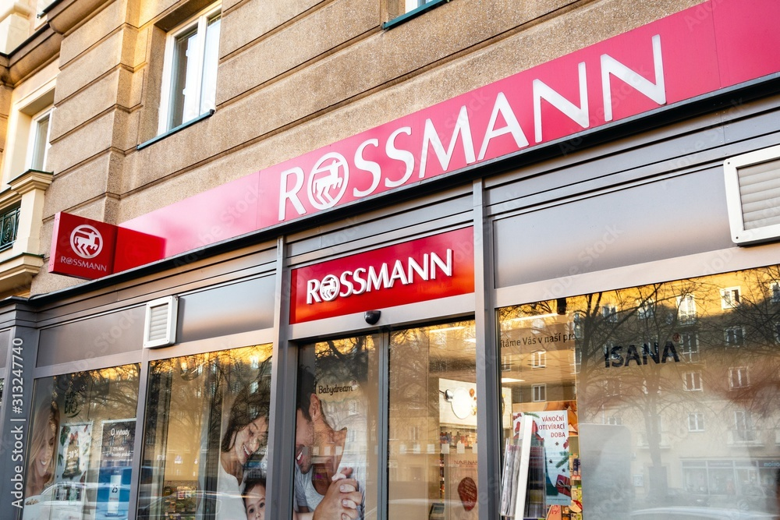
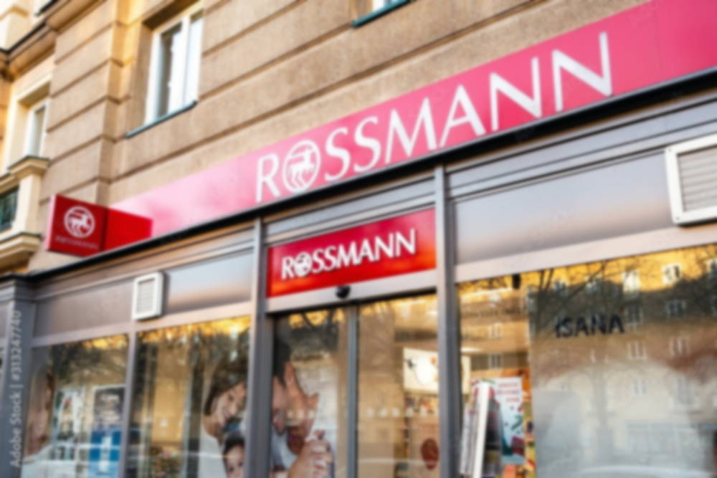
Rossmann Sales Forecasting
Rossmann Sales Forecasting
Presented by
Zhen Xue, Gue (33521352)
Chun Kei, Chow (33520771)
Sunaina, Rayaprol (33944091)
Hui Shawn, Lim (34017259)

Slide 2
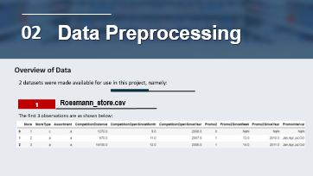
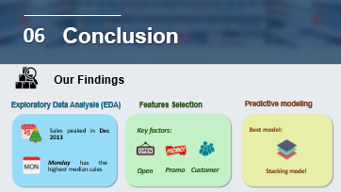
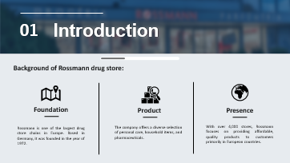
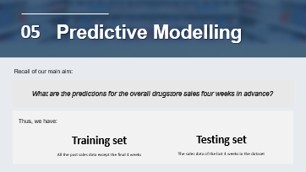
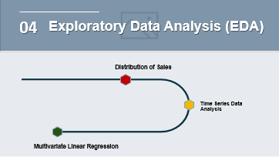
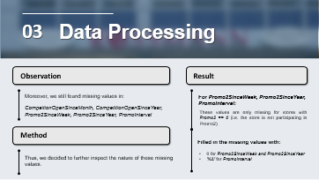
TABLE OF CONTENTS

Slide 3





Introduction
01
Background of Rossmann drug store:
Their desire
Understand and forecast trends
Foundation
As a consumer-facing business, sales are a major indicator of customer satisfaction and effective business management. By understanding and forecasting sales trends, store managers can better plan resources and meet customer demands.
Product
Presence
Rossmann is one of the largest drug store chains in Europe. Based in Germany, it was founded in the year of 1972.
The company offers a diverse selection of personal care, household items, and pharmaceuticals.
With over 4,000 stores, Rossmann focuses on providing affordable, quality products to customers primarily in European countries.

Slide 4
Introduction
01
Their desire
Research questions
Understand and forecast trends
1
Foundation
As a consumer-facing business, sales are a major indicator of customer satisfaction and effective business management. By understanding and forecasting sales trends, store managers can better plan resources and meet customer demands.
Product
Presence
Rossmann is one of the largest drug store chains in Europe. Based in Germany, it was founded in the year of 1972.
The company offers a diverse selection of personal care, household items, and pharmaceuticals.
With over 4,000 stores, Rossmann focuses on providing affordable, quality products to customers primarily in European countries.
2

Slide 5
Introduction
01
Research questions
Understand and forecast trends
What would the trend of sales be like?
1
We aim to develop a machine learning model capable of predicting daily sales for Rossmann Stores.
As a consumer-facing business, sales are a major indicator of customer satisfaction and effective business management. By understanding and forecasting sales trends, store managers can better plan resources and meet customer demands.
What factors affect sales?
2
We aim to develop a machine learning model capable of estimating the number of sales based on the potential factors.

Slide 6

Data Preprocessing
02
Overview of Data
Overview of Data
2 datasets were made available for use in this project, namely:
1
Rossmann_store.csv
The first 3 observations are as shown below:
It contains the details of:
1115
10
stores
AND
variables*
* 10 variables : Store, Store type, Assortment, CompetitionDistance, CompetitionOpenSinceMonth, CompetitionOpenSinceYear, Promo2, Promo2SinceWeek, Promo2SinceYear, PromoInterval
* Missing values found in: CompetitionDistance, CompetitionOpenSinceMonth, CompetitionOpenSinceYear, Promo2SinceWeek, Promo2SinceYear, PromoInterval

Slide 7
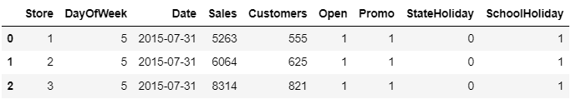
Data Preprocessing
02
Overview of Data
Overview of Data
2 datasets were made available for use in this project, namely:
1
Rossmann_store.csv
2
Rossmann_train.csv
The first 3 observations are as shown below:
The first 3 observations are as shown below:
It contains the details of:
It contains the historical sales data:
1115
10
stores
AND
1,017,209
9
variables*
observations
AND
variables*
* 10 variables : Store, Store type, Assortment, CompetitionDistance, CompetitionOpenSinceMonth, CompetitionOpenSinceYear, Promo2, Promo2SinceWeek, Promo2SinceYear, PromoInterval
* 10 variables : Store, DayOfWeek, Date, Sales, Customers, Open, Promo, StateHoliday, SchoolHoliday
* Missing values found in: CompetitionDistance, CompetitionOpenSinceMonth, CompetitionOpenSinceYear, Promo2SinceWeek, Promo2SinceYear, PromoInterval
* No missing values exist in any of the columns.

Slide 8


Overview of Data
2 datasets were made available for use in this project, namely:
1
Rossmann_store.csv
2
Rossmann_train.csv
The first 3 observations are as shown below:
The first 3 observations are as shown below:
It contains the details of:
It contains the historical sales data:
1115
10
stores
AND
1,017,209
9
variables*
observations
AND
variables*
* 10 variables : Store, Store type, Assortment, CompetitionDistance, CompetitionOpenSinceMonth, CompetitionOpenSinceYear, Promo2, Promo2SinceWeek, Promo2SinceYear, PromoInterval
* 9 variables : Store, DayOfWeek, Date, Sales, Customers, Open, Promo, StateHoliday, SchoolHoliday
* Missing values found in: CompetitionDistance, CompetitionOpenSinceMonth, CompetitionOpenSinceYear, Promo2SinceWeek, Promo2SinceYear, PromoInterval
* No missing values exist in any of the columns.
Our Approach
For this project, we focused on analysing the top 20% of stores in terms of sales.
Filtering & Merging
Result

Slide 9
Overview of Data
2 datasets were made available for use in this project, namely:
2
Rossmann_train.csv
The first 3 observations are as shown below:
It contains the historical sales data:
1,017,209
9
observations
AND
variables*
* 10 variables : Store, DayOfWeek, Date, Sales, Customers, Open, Promo, StateHoliday, SchoolHoliday
* No missing values exist in any of the columns.
Data Preprocessing
02
Our Approach
For this project, we focused on analysing the top 20% of stores in terms of sales.
Filtering & Merging
Result
Calculate Average Sales
Therefore, we got..
We calculated the average sales for each store over the 31-month period in the data (+ add this information into the store dataframe)
1
A Single Dataframe
Obtain top 20% of stores
A single dataframe, containing the past sales data of 223 stores
Next, we obtained the store IDs of the top 20% of stores in terms of sales from the store dataframe (avg. sales ≥ 80% quantile)
Filtering
2
Complete Variables
Filtered both the store dataset & sales dataset by the Store IDs obtained
18 variables with Date set as index
Merging
Finally, we merged the store dataframe & sales dataframe on the Store IDs

Slide 10
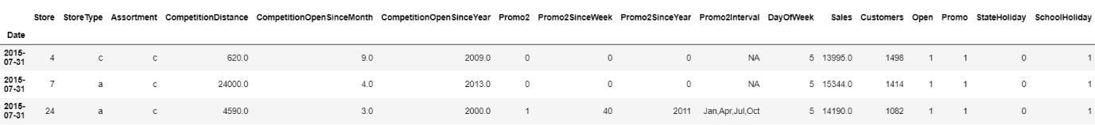
Data Preprocessing
02
Overview of Preprocessed Data
The first 3 observations of the combined data frame:

Slide 11
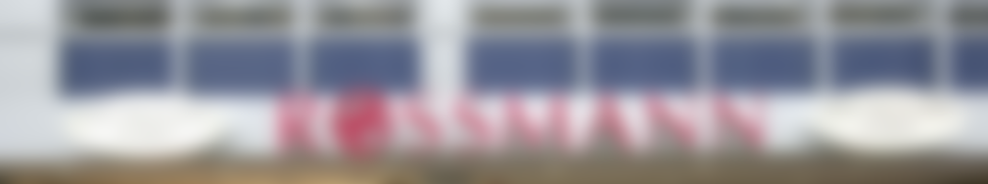
Data Processing
03
Observation
Result
Imputation
Moreover, we still found missing values in:
CompeitionOpenSinceMonth, CompetitionOpenSinceYear, Promo2SinceWeek, Promo2SinceYear, PromoInterval
For Promo2SinceWeek, Promo2SinceYear, PromoInterval:
These values are only missing for stores with Promo2 == 0 (i.e. the store is not participating in Promo2)
Method
1
Simple Imputation
2
kNN Imputation
Filled in the missing values with:
Thus, we decided to further inspect the nature of these missing values.
0 for Promo2SinceWeek and Promo2SinceYear
'NA' for PromoInterval

Slide 12
Data Processing
03
Observation
Result
Imputation
Moreover, we still found missing values in:
CompeitionOpenSinceMonth, CompetitionOpenSinceYear, Promo2SinceWeek, Promo2SinceYear, PromoInterval
For Promo2SinceWeek, Promo2SinceYear, PromoInterval:
These values are only missing for stores with Promo2 == 0 (i.e. the store is not participating in Promo2)
Method
1
Simple Imputation
2
kNN Imputation
Filled in the missing values with:
Thus, we decided to further inspect the nature of these missing values.
0 for Promo2SinceWeek and Promo2SinceYear
'NA' for PromoInterval

Slide 13
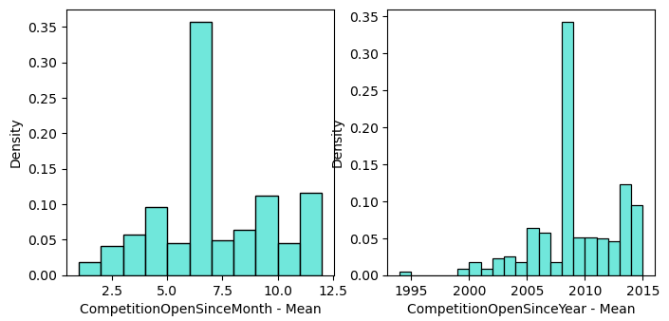
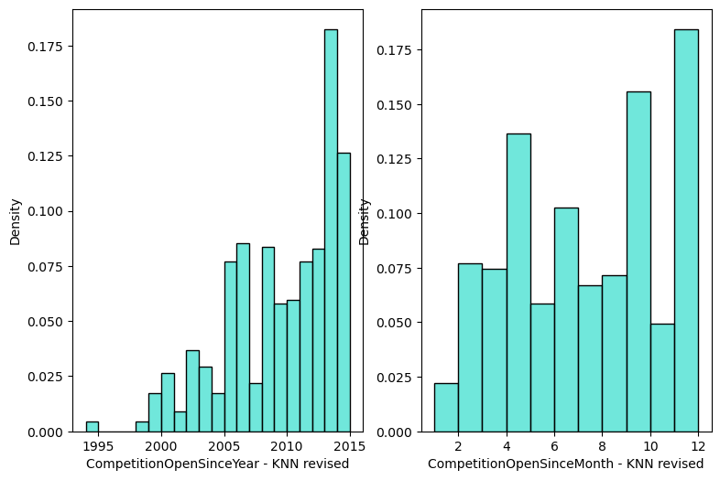
Data Processing
03
1
Simple Imputation
Initially, we filled in missing values using mean and median:
Obvious peak shown in histogram…
2
kNN Imputation
Then, we tried out using kNN imputation:
A bell shape curve histogram!

Slide 14
2
kNN Imputation
Then, we tried out using kNN imputation:
A bell shape curve histogram!

Slide 15
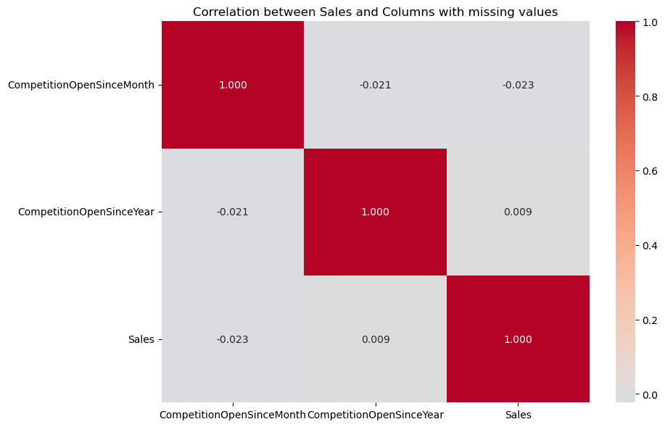
2
kNN Imputation
The bell shape curve is not perfect as CompetitionOpenSinceYear and CompetitionOpenSinceMonth has very weak correlation with target variable ‘Sales’.

Slide 16

Exploratory Data Analysis (EDA)
04
Distribution of Sales
Time Series Data Analysis
Multivariate Linear Regression

Slide 17
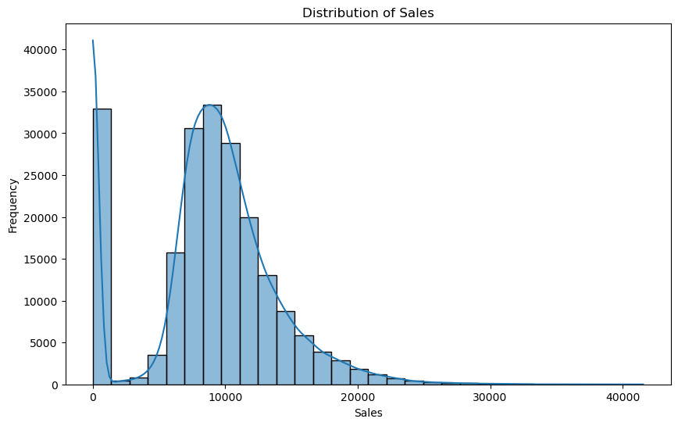
Distribution of Sales
We visualised the distribution of sales using a histogram.
Why?*
Perfect bell curve!
*This is common in retail datasets where certain stores may not have sales on specific days or during certain periods (not open).

Slide 18
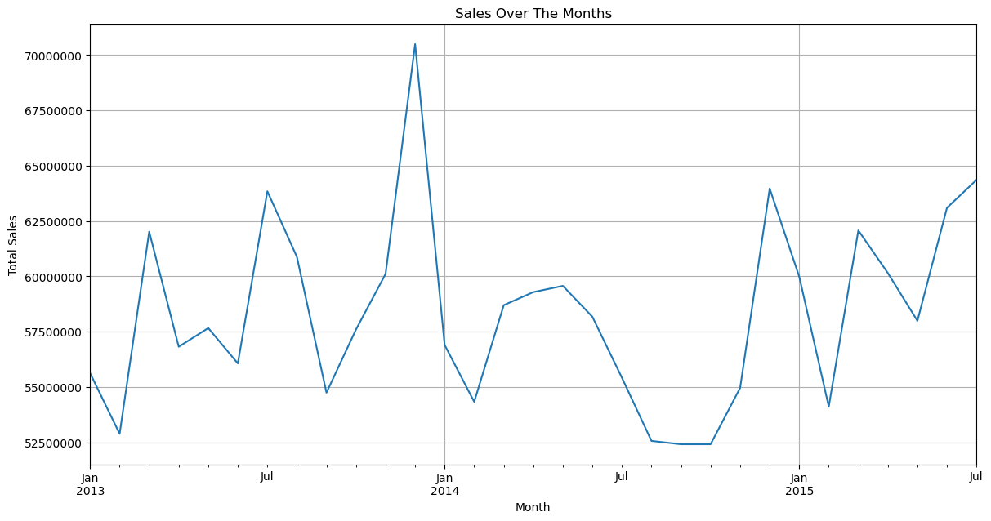
Time Series Data Analysis – Over Months
We visualised the trend of sales for each month.
Observation:
Sales peaked in December 2013, declined until October 2014, then rose again in December 2014.

Slide 19
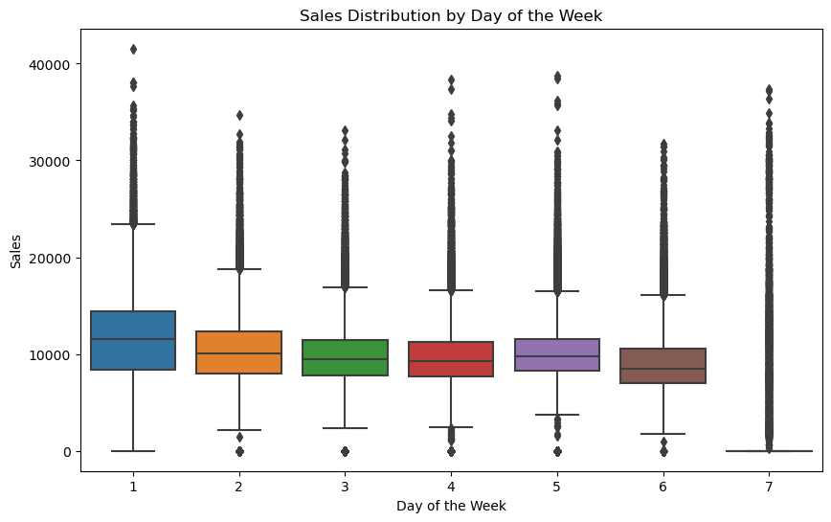
Time Series Data Analysis – Over Week
We visualised the distribution of sales for each day of the week.
Observations :
Monday has the highest median sales and wider variability.
Sunday shows the lowest median and extreme outliers.
Tuesday to Friday exhibit consistent sales with a few outliers, particularly on Monday and Saturday.

Slide 20
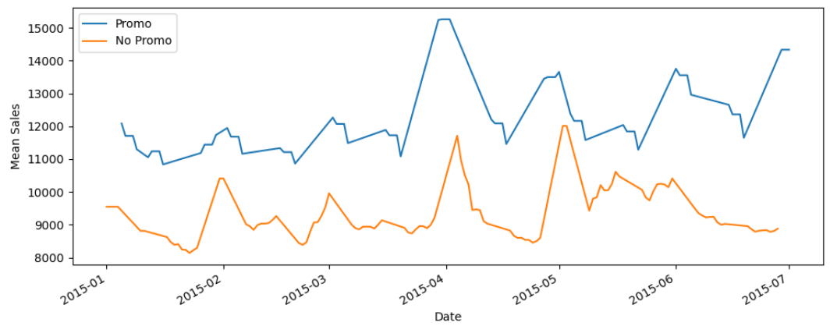
Time Series Data Analysis – Rolling Mean
Next, we used the rolling mean technique to investigate the effect of Promo.
Observations :
Aligning with our expectations, promotions seemed to have a noticeably positive effect on sales.
This is because lower prices would make products more affordable and motivate consumers to get the most of their money’s worth.

Slide 21
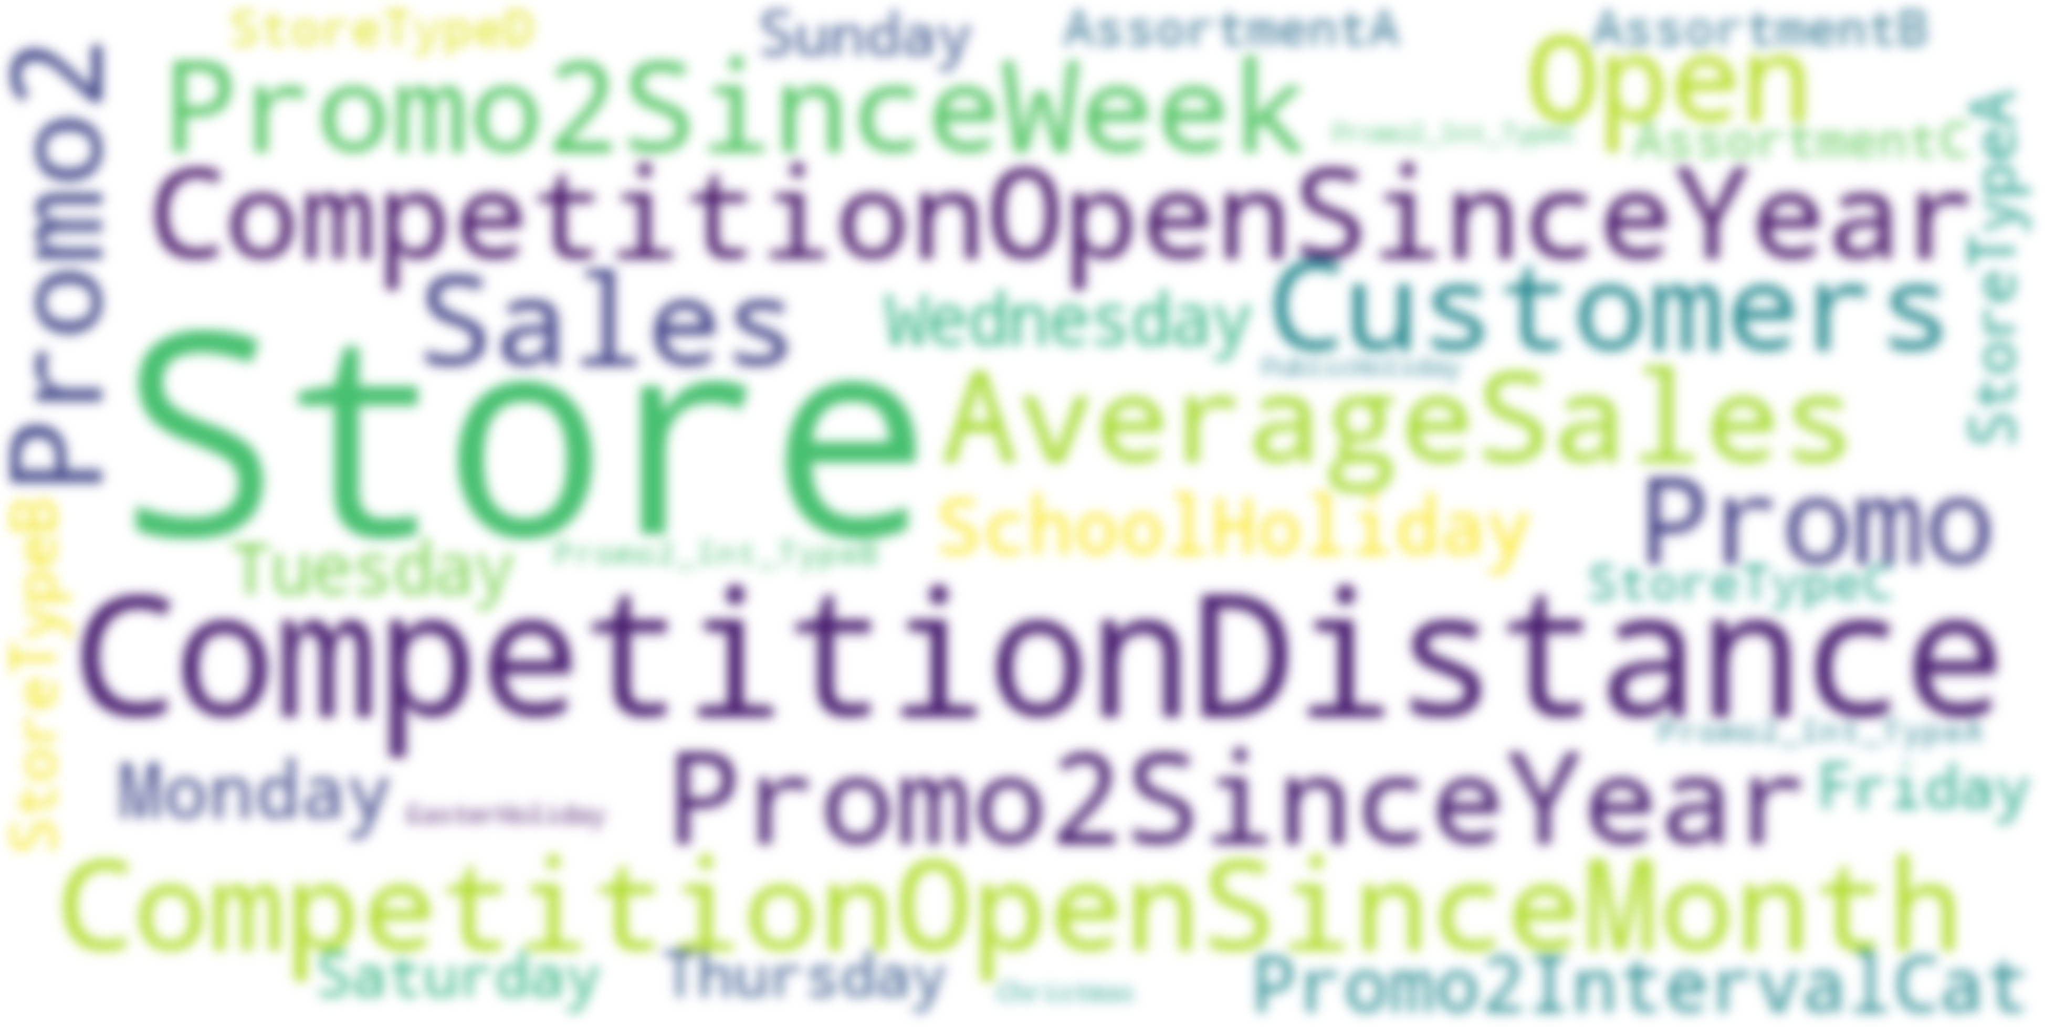

Multivariate Linear Regression
We have numerous of factors that may affect sales.
Which of them are the key factors?

Slide 22
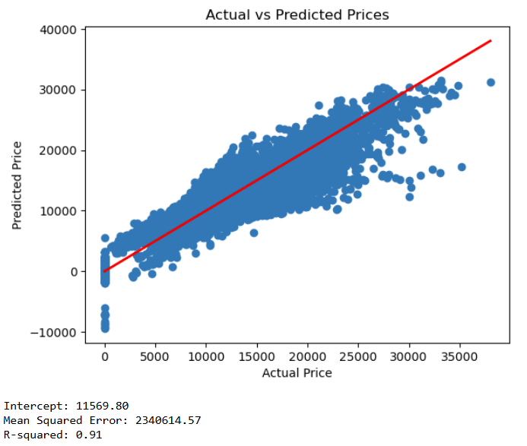
Multivariate Linear Regression
We did some simple modelling to test the feasibility of the MLR model
This model could not be accepted as,
It receives noise.
0.91 of R-squared value indicates that it overfits. It is receiving all variables regardless of relevance. Thus, it does not generalise well to the testing data.
Large intercept values
The intercept suggested that if all factors influencing sales were at their baseline levels, we would still set the baseline sales value as 11569.80. This is unreasonable.

Slide 23
Multivariate Linear Regression
Thus, we did a few approaches to simplify our model. These includes:
1
2
3
Analysis of Correlation
Analysis of Coefficients
Regularisation

Slide 24
Multivariate Linear Regression
1
Analysis of Correlation
Result
We left with variables below:
PublicHoliday
Sunday
Monday
Promo
Open
Customers
What we did
We filtered out variables with correlations less than 0.2.

Slide 25
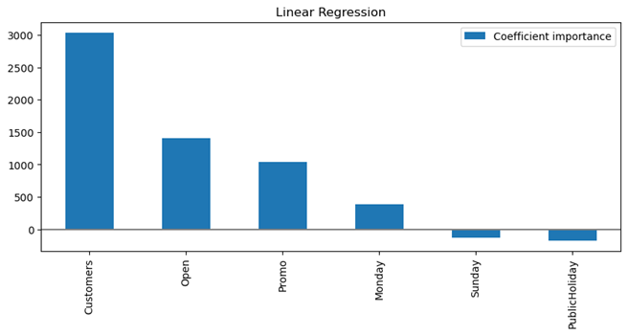
Multivariate Linear Regression
2
Analysis of Coefficients
What we did
We investigated the importance of model coefficients by its coefficient values and standard deviation.
Result
This suggested that Customers, Open and Promo are the top 3 most important variables contributing to sales.

Slide 26
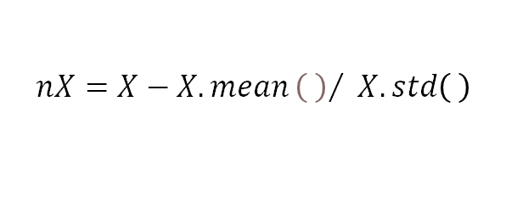
Multivariate Linear Regression
3
Regularisation
We determined whether we should be using Lasso or Ridge regularisation methods.
We considered that,
What we did
Feature selection is important
Interpretability is Crucial
Strong Feature Correlation
First,
We normalised all the data using:
$$nX=X−X.mean{\left( \right)}/ X.std\left( \right)$$
Thus, we chose to use:
Lasso Regularisation

Slide 27
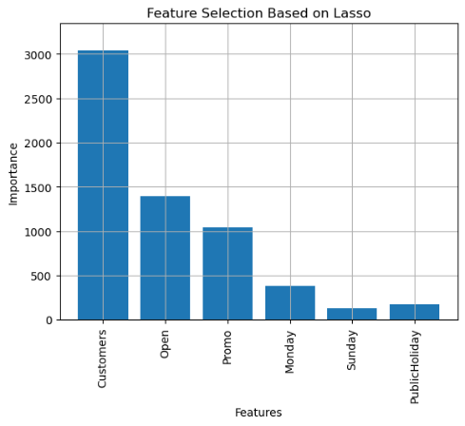
Multivariate Linear Regression
Lasso Regularisation
Hyperparameter tuning
To find the optimal value of regularisation parameter `alpha`.
We generated 50 values between:
10⁻⁴
10¹
AND
to find the optimal value of regularisation parameter `alpha`. In this case,
Result
This suggested that Customers, Open and Promo are the top 3 most important variables contributing to sales.
Optimal alpha value is: 0.0176

Slide 28
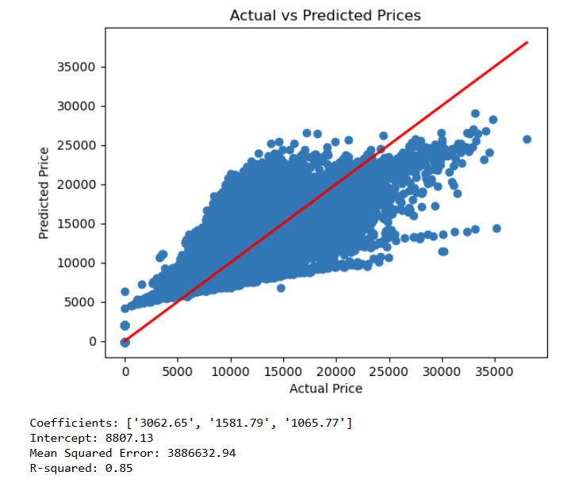
Multivariate Linear Regression
Our final result is as below:
Comparing to the initial model,
Its generalisability increased.
85% of the variance in the sales data is explained by the model.
Reasonable initial baseline
The value of baseline decreased, which is near to the value it supposed to be.
Final Result:
$$Sales=8807.13+3062.85x_{1}+1581.79x_{2}+1065.77x_{3}$$
$Sales_{pred}$ stands for predicted sales, x₁ stands for number of customers, x₂ stands for the availability of the store, and x₃ stands for the availability of promotion.

Slide 29
Predictive Modelling
05
Overview of Data
Recall of our main aim:
What are the predictions for the overall drugstore sales four weeks in advance?
Thus, we have:
Training set
All the past sales data except the final 4 weeks
Testing set
The sales data of the last 4 weeks in the dataset

Slide 30
Single Regression Tree
Optimal max_depth giving least difference between training and testing score: 7

Slide 31
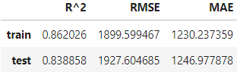
Ensemble learning- Random Forest Regression

Slide 32








Ensemble learning – Bagging
Model 1
Ensemble model
Model 2
Predict and aggregate
Bagging
Model 3

Slide 33
Ensemble learning – Boosting
Model 1
Predict
Model 2
Predict
Ensemble model
modify
Model 3
modify
Boosting
Predict

Slide 34
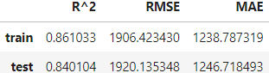
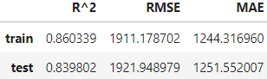
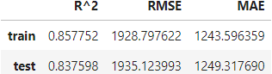
Ensemble learning – Boosting
AdaBoostRegressor
GradientBoostRegressor
XGBoost

Slide 35
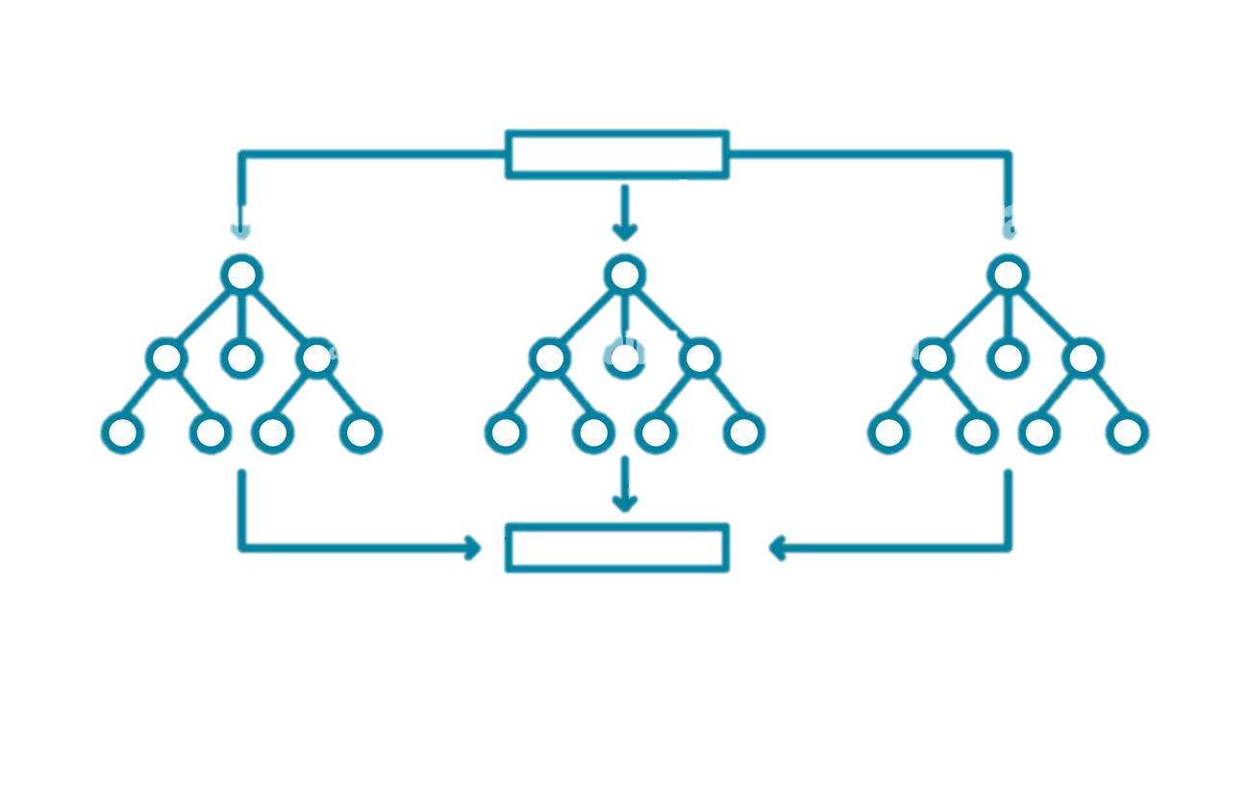


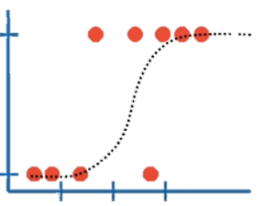

Ensemble learning – Stacking
Random Forest Regressor
Bagging
K-NN Regressor
Logistic regression
Stacking Model

Slide 36

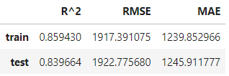

Ensemble learning – Stacking

Slide 37



Conclusion
06
Overview of Data
Our Findings
Exploratory Data Analysis (EDA)
Features Selection
Predictive modeling
Sales peaked in Dec 2013
Key factors:
Best model:
Monday has the highest median sales
Open
Promo
Customer
Stacking model

Slide 38
1
Increase the frequency for store opening, ideally everyday.
2
Increase the frequency of promo events.
Our Suggestions

